Slide 1




W
HACKTOBERFEST 1.0

Slide 2




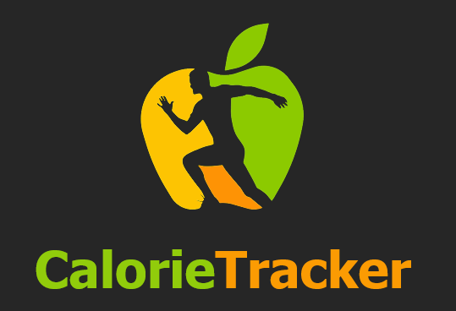


Calorie Tracker
challenge of effective calorie intake monitoring and providing personalized diet recommendation
The Problem statement is critically important and relevant to the target audience for several reasons:
Health and Well-being:
Nutritional Awareness
Fitness Enthusiasts:
Diet Efficiency:
PROVIDE STATISTICS OR DATA TO SUPPORT YOUR ARGUMENT.

Slide 3
Diet-Related Diseases:
The Centers for Disease Control and Prevention (CDC) reports that diet-related diseases, including heart disease,
stroke, type 2 diabetes, and certain types of cancer, are some of the leading causes of preventable deaths in
the United States.
Rising Diabetes Prevalence:
India is often referred to as the diabetes capital of the world. The International Diabetes Federation (IDF)
estimated that in 2021, 77 million adults in India had diabetes, emphasizing the need for dietary
management and monitoring of calorie intake.
Nutritional Deficiencies:
The Comprehensive National Nutrition Survey (CNNS) conducted in India revealed that nutritional deficiencies
are widespread, with many Indians lacking essential nutrients such as iron, vitamin D, and vitamin B12.
Increased Use of Diet and Fitness Apps:
There has been a notable increase in the use of diet and fitness apps in India.
As more people become health-conscious, these apps have become essential tools for calorie tracking and
dietary guidance.
Government Initiatives:
The Government of India has launched initiatives like the "Eat Right India"
campaign to promote healthy eating and nutrition awareness. This underscores the significance of nutrition
and dietary management.

Slide 4




Solution
Our comprehensive web and mobile platform seamlessly merges nutrition tracking, personalized dietary planning, and health-conscious choices, fostering a healthier world through data-driven wellness..

Slide 5
USE CASES
The "User" interacts with the “Web App" through various use cases.
Use Case 1 represents user registration and login.
Use Case 2 involves setting goals and dietary preferences.
Use Case 3 allows users to track their calorie intake and meals.
Use Case 4 involves the generation of customized diet plans.
Use Case 5 focuses on conducting nutritional analysis.
Use Case 6 is for monitoring user progress.
Use Case 7 encompasses user engagement and notifications.
Use Case 8 involves sharing and community features.
Use Case 9 addresses data security and privacy.
Use Case 10 deals with monetization strategies.
Use Case 11 feedback collection .

Slide 6


Key Features and Functionality
User-Friendly Interface (visually appealing, and easy-to-navigate website interface)
User Registration ( Signing/signup using email or social media login options.
personalized profiles, including age, weight, dietary preferences, and fitness goals.)
Calorie Intake Monitoring: real-time updates of calorie consumption and remaining daily allowances.
Food Database and Search Functionality:
Maintain an extensive food database with nutritional information.
Customizable Diet Plans:
Generate personalized diet plans based on user goals, such as weight loss, maintenance, or muscle gain.
Goal Setting and Progress Tracking
User Feedback and Ratings

Slide 7


Social impact
GOALS: reducing the prevalence of obesity, improving overall health and nutrition awareness, and promoting sustainable dietary practices.
OBJECTIVE : goals with the broader mission of promoting healthier eating habits and better nutritional understanding
creating partnerships with organizations focused on nutrition education and public health.
implementing a "freemium" model
user surveys, feedback mechanisms, and data analytics to collect information on how your platform is affecting users' behavior and health outcomes.

Slide 8


Revenue Model
The social impact of our business model is evident in our mission to improve overall health and nutritional awareness. By providing a user-friendly calorie tracking and dietary management platform, we empower individuals to make informed dietary choices, reduce obesity rates, and promote healthier eating habits. Our revenue model sustains this mission through subscription plans and partnerships, ensuring our commitment to creating a healthier world.
Subscription Plans and Partnerships. (freemium model )

Slide 9



Technologies Used
OUR TEAM UTILIZED A VARIETY OF TECHNOLOGIES INCLUDING
FROUNT END →
HTML ,CSS,JAVA SCRIPT ,BOOTSTRAP,jQuery
BACKEND →Frameworks Node.js , Django , DBMS
GITHUB AND AWS. Etc

Slide 10


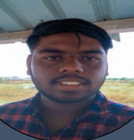
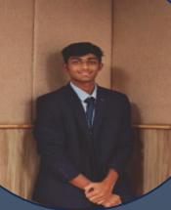
The Team
Harshil Dhoot
Frount End
Shubham kumar bind
lead
Sukant SAUMYA
Backend

Slide 11


Thank You
HACKTOBER FEST

